Slide 1
Machine learning
Regent College London
SWE6204

Slide 2
Machine learning
SWE6204

Slide 3

Machine learning
INTRODUCTION TO NEURAL NETWORK

Slide 4
Module 1 – Introduction to neural network

Slide 5
Learning objectives
Master the key concepts associated with Multilayer-perceptron networks
Understand the Linear Threshold Unit (LTU)
Understand the Perceptron

Slide 6
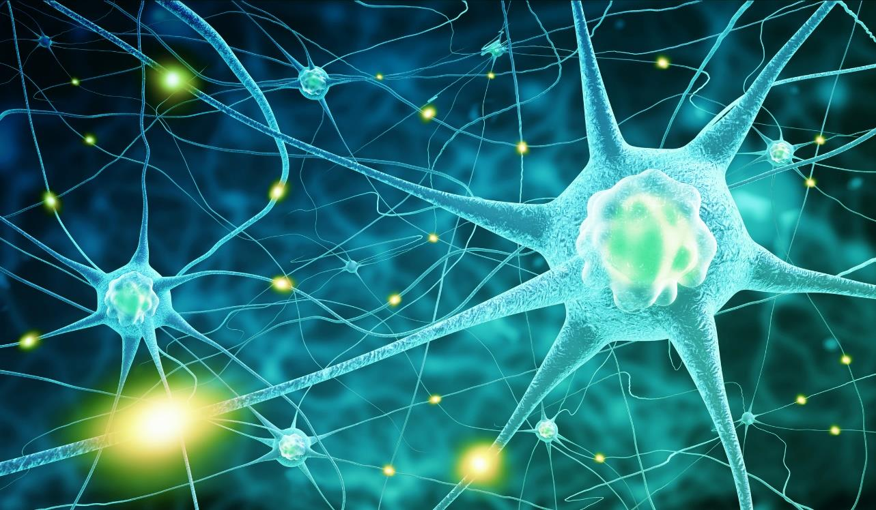
Biological inspiration
Neurons in your cerebral cortex are connected via axons
A neuron “fires” to the neurons it’s connected to, when enough of its input signals are activated.
Very simple at the individual neuron level – but layers of neurons connected in this way can yield learning behaviour.
Billions of neurons, each with thousands of connections, yields a mind

Slide 7
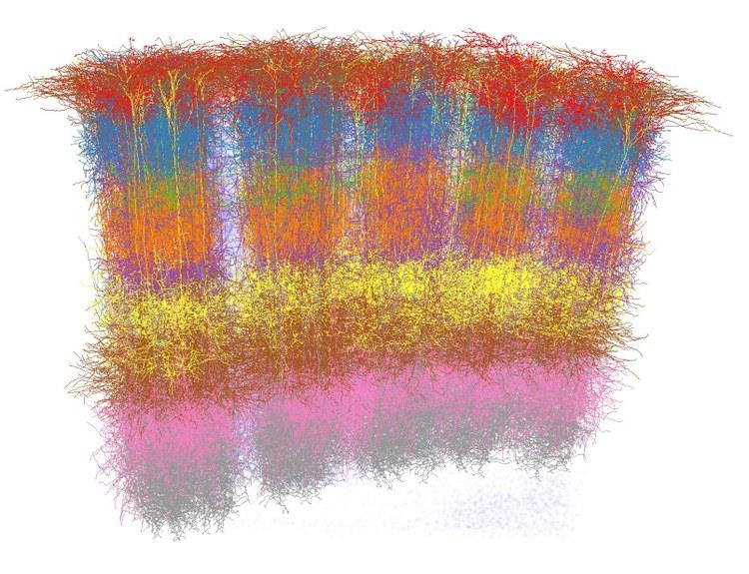
Cortical columns
Neurons in your cortex seem to be arranged into many stacks, or “columns” that process information in parallel
“mini-columns” of around 100 neurons are organized into larger “hyper- columns”. There are 100 million mini- columns in your cortex
This is coincidentally similar to how GPU’s work
(credit: Marcel Oberlaender et al.)

Slide 8
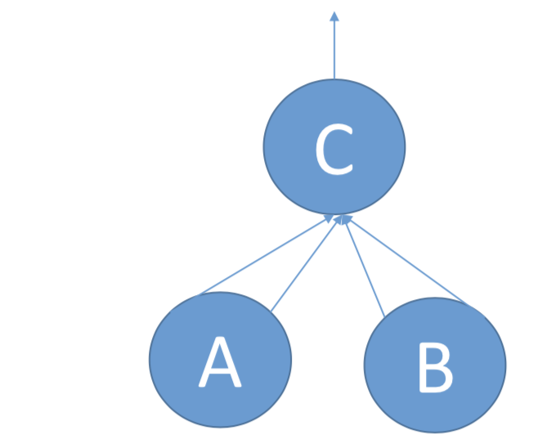
The first artificial neuron
1943 !
An artificial neuron “fires” if more than N input connections are active.
Depending on the number of connections from each input neuron, and whether a connection activates or suppresses a neuron, you can construct AND, OR, and NOT logical constructs this way.
This example would implement C = A OR B if the threshold is 2 inputs being active.

Slide 9
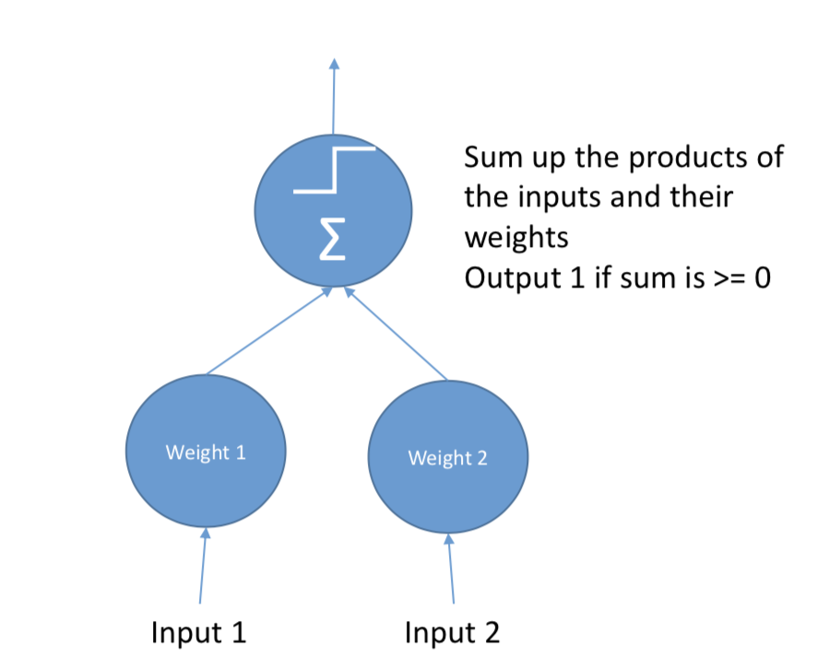
linear THRESHOLD UNIT (LTU)
1957!
Adds weights to the inputs; output is given by a step function

Slide 10
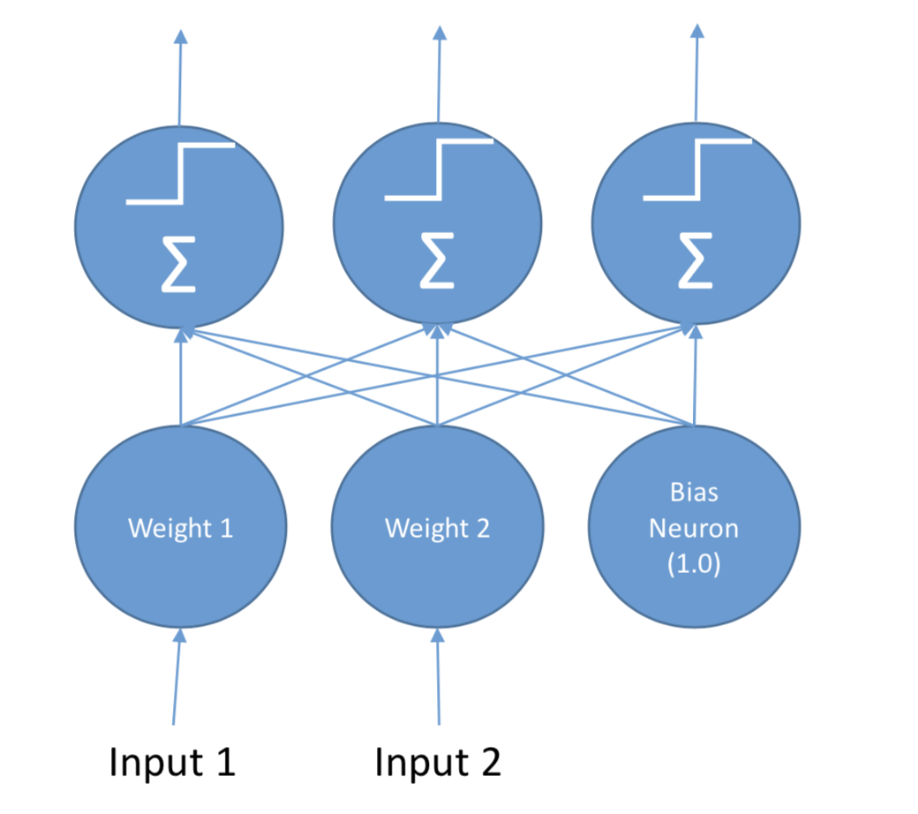
perceptron
A layer of LTU’s
A perceptron can learn by reinforcing weights that lead to correct behavior during training
This too has a biological basis (“cells that fire together, wire together”)

Slide 11
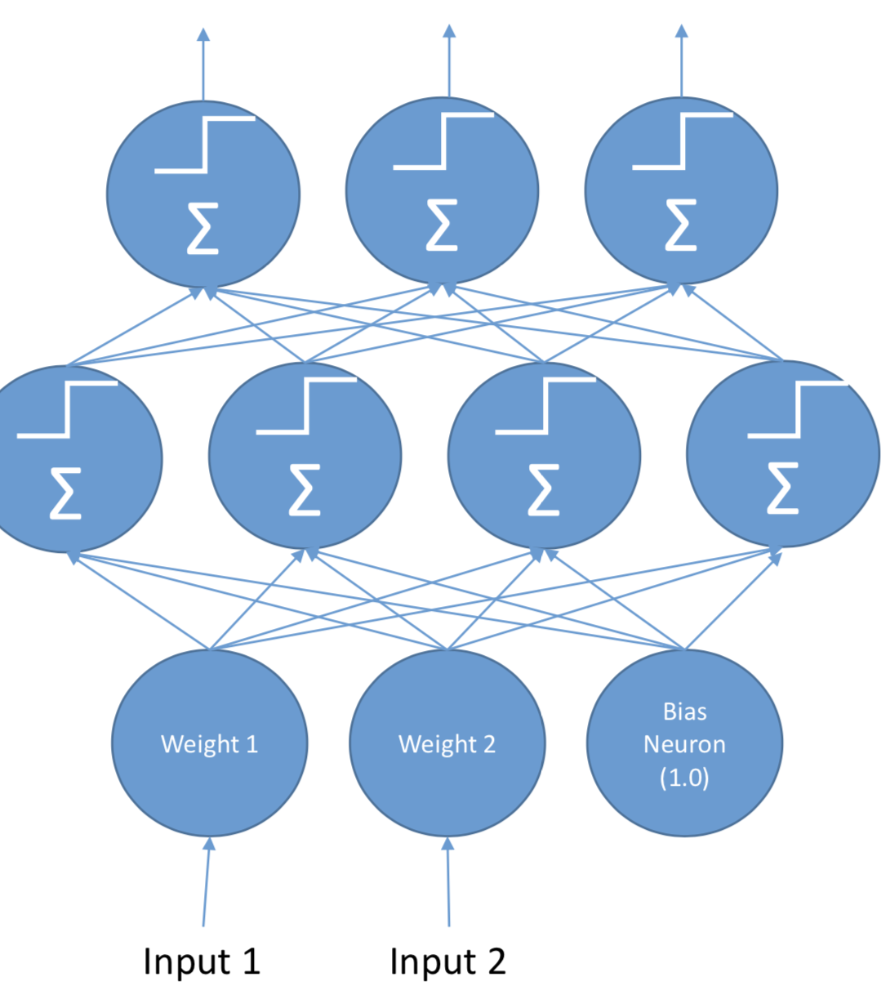
Multilayer perceptron (MLP)
Addition of “hidden layers”
This is a Deep Neural Network
Training them is trickier – but we’ll talk about that.

Slide 12
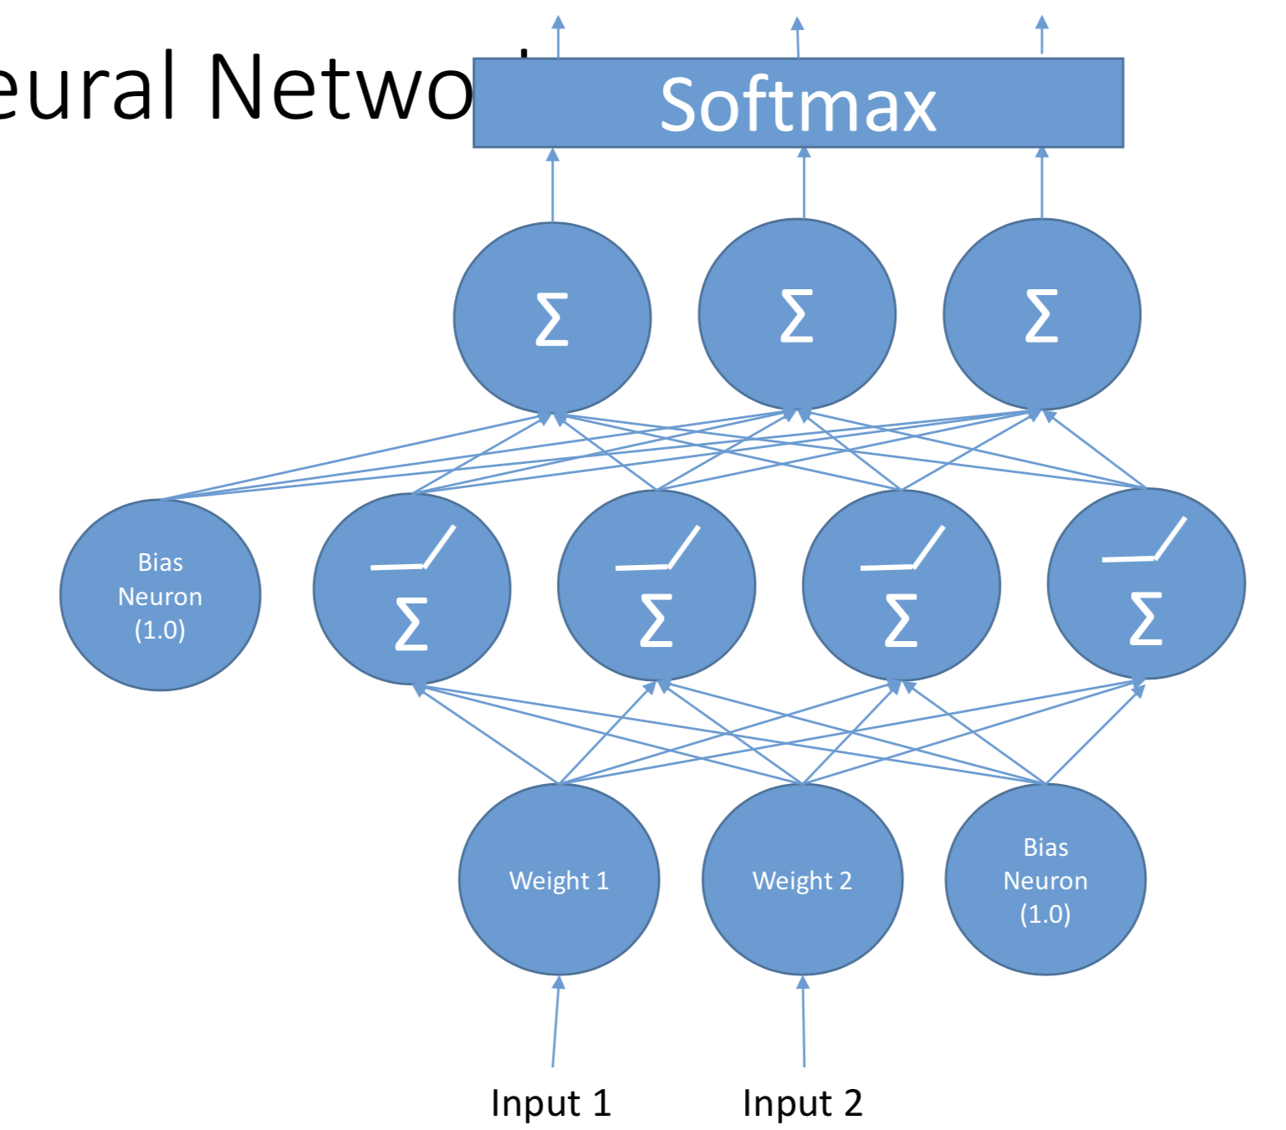
Modern deep neural network
Replace step activation function with something better
Apply softmax to the output
Training using gradient descent

Slide 13
Understanding neural network
Can you please watch the video below.
https://www.youtube.com/watch?v=bfmFfD2RIcg

Slide 14
Gradient decent method

Slide 15
Back-propagation algorithm
Watch the video to understand Backpropagation in more detail.
https://www.youtube.com/watch?v=GltT9b31fRY
Watch the video to understand Gradient Decent in more detail.
https://www.youtube.com/watch?v=qg4PchTECck

Slide 16
+44 (0)207 016 8000
info@rcl.ac.uk

